Slide 1


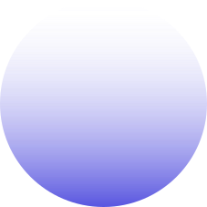
GOVERNMENT COLLEGE OF ENGINEERING AND CERAMIC TECHNOLOGY
PROJECT SURVEY PRESENTATION
Deep learning method to detect infection caused by “Novel Corona Virus pneumonia” from High resolution CT images.
Presented On 04/05/2024
Presented by
Group 3
DEPARTMENT OF INFORMATION TECHNOLOGY

Slide 2

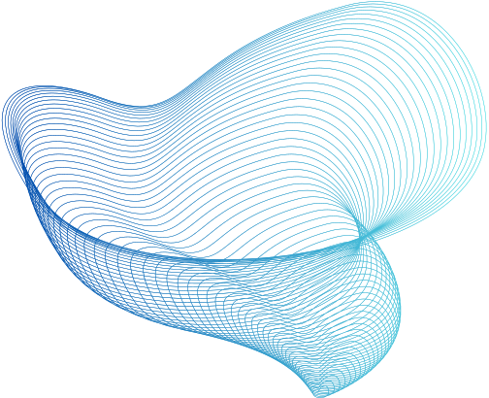



﻿Meet The Group
SOURAV
SUMIT
SOUMYAPIA
R21-2032
R21-2038
R21-2031

Slide 3
PROJECT TITLE: DEEP LEARNING METHOD TO DETECT INFECTION CAUSED BY “NOVEL CORONA VIRUS PNEUMONIA” FROM HIGH RESOLUTION CT IMAGES.
Project Description: Computed tomography (CT) is the preferred imaging method for diagnosing COVID-19 pneumonia. The proposed project aims to construct a system based on deep learning for detecting COVID-19 pneumonia on high resolution CT for its cost effectiveness over RTPCR test. In this project a model based approach is to be adopted on top of powerful training algorithms for medical image segmentation and identification. To train the model CT images may be randomly chosen from the available dataset. A survey work may be performed among the available network architectures related to this work

Slide 4
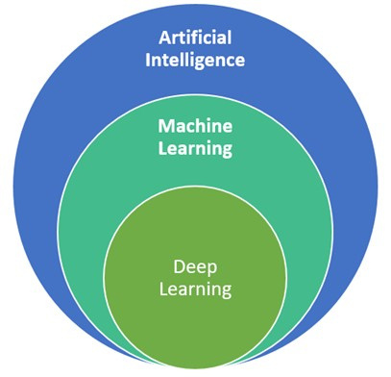
DEEP LEARNING
What is Deep Learning?
Deep Learning is a subfield of artifical intelligence and machine learning that is inspired by the structure of a human brain.

Slide 5
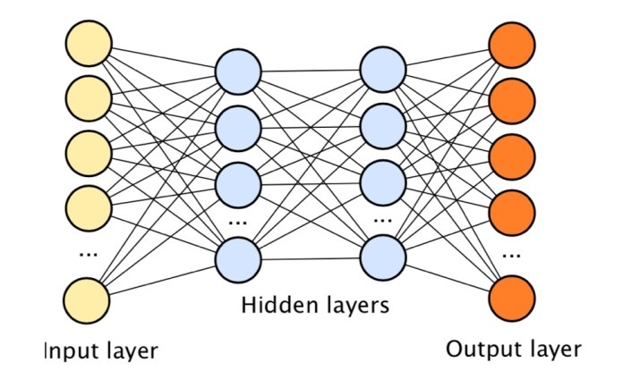
DEEP LEARNING
Deep Learning algorithms attemt to draw similar conclusion as human brain would by continuosly analysing data with a given logical structure called Nural Network

Slide 6
TYPES OF NURAL NETWORK
There are difference types of nural networks
ANN
Multilayer Perceptron (MLP)
Convolutional Neural Network (CNN)
Recurrent Neural Network (RNN)
Generative Adversarial Networks (GANs)

Slide 7
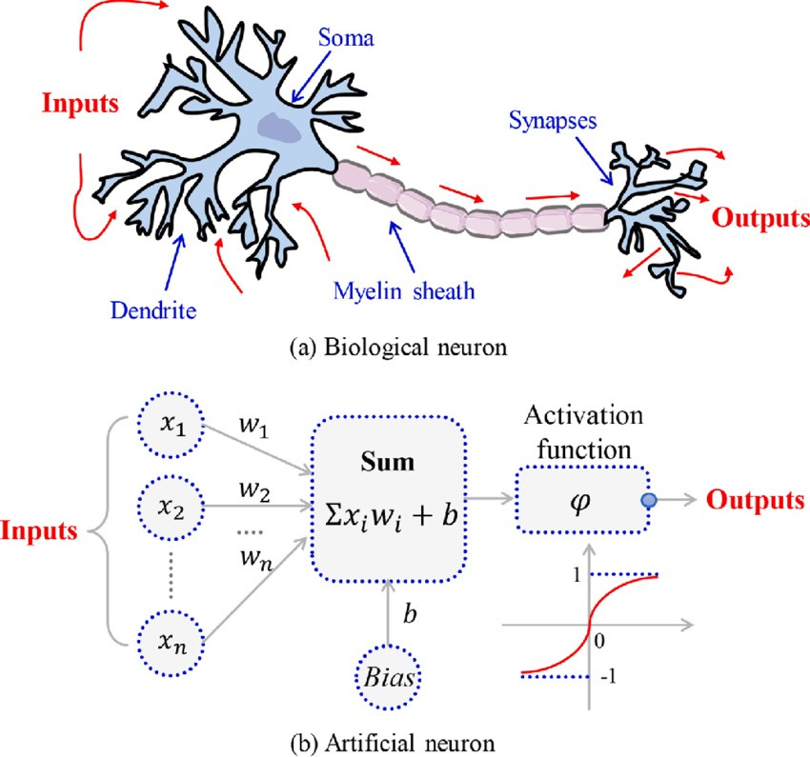
ANN
What is Perceptron?
Perceptron is Machine Learning algorithm for supervised learning of various binary classification tasks.

Slide 8
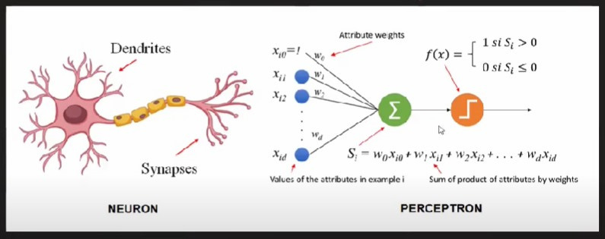
ANN

Slide 9
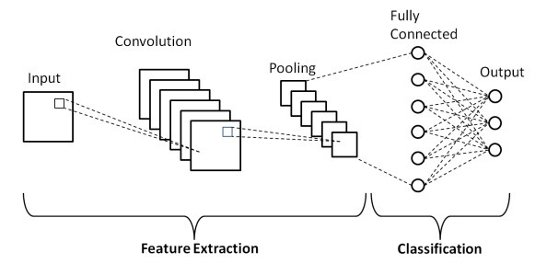
CNN

Slide 10
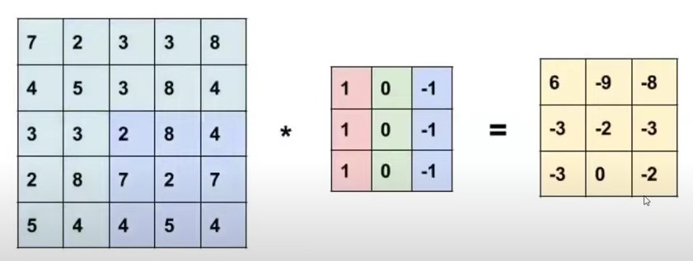
CNN
Convolutional Layers:
Convolutional layers are the building blocks of CNNs.
They consist of a set of learnable filters (also called kernels) that slide across the input image, computing the dot product between the filter and the input at every position.
The output of the convolution operation forms a feature map, highlighting the presence of different patterns or features in the input image.

Slide 11
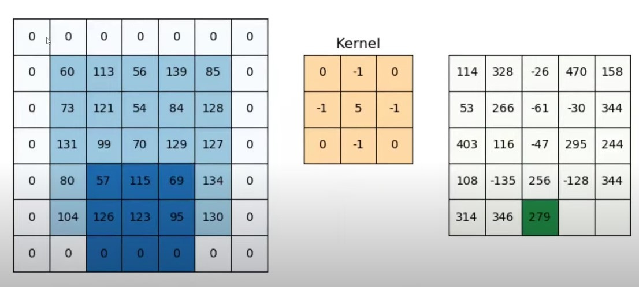
PADDING

Slide 12
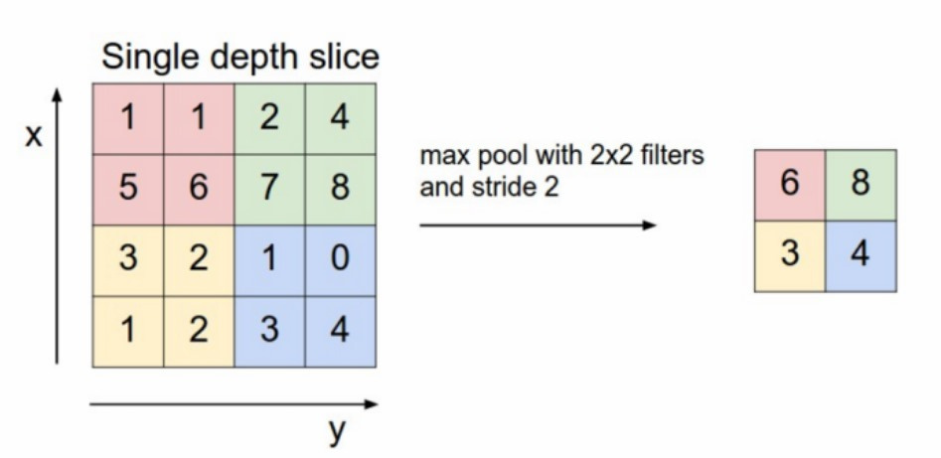
CNN
Pooling Layers:
Pooling layers are used to downsample the feature maps obtained from convolutional layers.
Common pooling operations include max pooling and average pooling, which reduce the spatial dimensions of the feature maps while retaining the most important information.
Pooling helps in achieving translation invariance and reducing computational complexity.

Slide 13
CNN
Activation Functions:
Activation functions introduce non-linearity into the network, allowing it to learn complex patterns.
Common activation functions used in CNNs include ReLU (Rectified Linear Unit), sigmoid, and tanh.
ReLU is preferred due to its simplicity and effectiveness in addressing the vanishing gradient problem.

Slide 14
CNN
Fully Connected Layers:
Fully connected layers are typically used towards the end of the CNN architecture to perform classification or regression tasks.
They take the output of the convolutional and pooling layers and transform it into a vector representation suitable for the final task.
These layers are often followed by a softmax activation function for classification tasks to produce class probabilities.

Slide 15
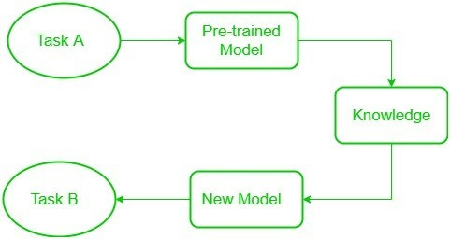
TRANSFER LEARNING
What is Transfer Learning?
Transfer learning is a technique in machine learning where a model trained on one task is used as the starting point for a model on a second task. This can be useful when the second task is similar to the first task, or when there is limited data available for the second task. By using the learned features from the first task as a starting point, the model can learn more quickly and effectively on the second task.

Slide 16
TRANSFER LEARNING
What is Transfer Learning?
it is common to use a pre-trained model trained on a variety of images in a similar task, e.g models trained on ImageNet (1.2 million images with 1000 categories) and use features from them to solve a new task.
When dealing with transfer learning, we come across a phenomenon called the freezing of layers. A layer, it can be a CNN layer, hidden layer, a block of layers, or any subset of a set of all layers, is said to be fixed when it is no longer available to train. Hence, the weights of freeze layers will not be updated during training.
While layers that are not frozen follows regular training procedure. When we use transfer learning in solving a problem, we select a pre-trained model as our base model.
Now, there are two possible approaches to using knowledge from the pre-trained model.
The first way is to freeze a few layers of the pre-trained model and train other layers on our new dataset for the new task.
The second way is to make a new model, but also take out some features from the layers in the pre-trained model and use them in a newly created model. In both cases, we take out some of the learned features and try to train the rest of the model. This makes sure that the only feature that may be the same in both of the tasks is taken out from the pre-trained model, and the rest of the model is changed to fit the new dataset by training.

Slide 17
TRANSFER LEARNING
There are different type of pretrained model already exist
For Example -
RESNET 50 For Image Classification
UNET For Image Segmentation.......

Slide 18
RESNET
ResNet50 is a deep convolutional neural network (CNN) architecture that was developed by Microsoft Research in 2015. It is a variant of the popular ResNet architecture, which stands for “Residual Network.” The “50” in the name refers to the number of layers in the network, which is 50 layers deep.
ResNet50 has been trained on large datasets and achieves state-of-the-art results on several benchmarks. It has been trained on the ImageNet dataset, which contains over 14 million images and 1000 classes. On this dataset, ResNet50 achieved an error rate of 22.85% which is on par with human performance, which is an error rate of 5.1%.

Slide 19
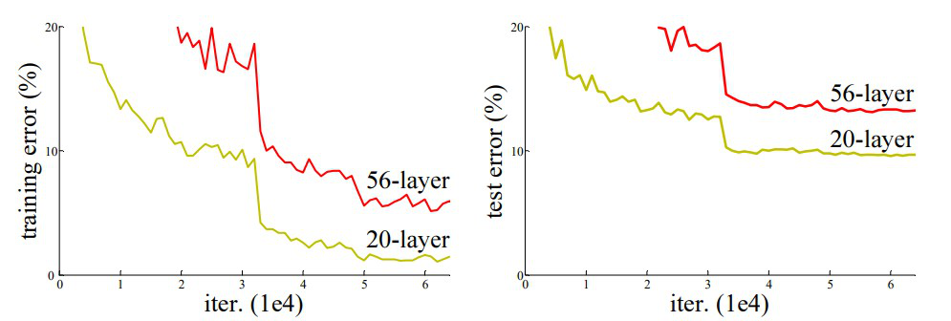
RESNET
In the above plot, we can observe that a 56-layer CNN gives more error rate on both training and testing dataset than a 20-layer CNN architecture. After analyzing more on error rate the authors were able to reach conclusion that it is caused by vanishing/exploding gradient.
ResNet, which was proposed in 2015 by researchers at Microsoft Research introduced a new architecture called Residual Network.

Slide 20
RESNET
Residual Network: In order to solve the problem of the vanishing/exploding gradient, this architecture introduced the concept called Residual Blocks. In this network, we use a technique called skip connections. The skip connection connects activations of a layer to further layers by skipping some layers in between. This forms a residual block. Resnets are made by stacking these residual blocks together.

Slide 21
RESNET
The 50-layer ResNet architecture includes the following elements, as shown in the table below:
A 7×7 kernel convolution alongside 64 other kernels with a 2-sized stride.
A max pooling layer with a 2-sized stride.
9 more layers—3×3,64 kernel convolution, another with 1×1,64 kernels, and a third with 1×1,256 kernels. These 3 layers are repeated 3 times.
12 more layers with 1×1,128 kernels, 3×3,128 kernels, and 1×1,512 kernels, iterated 4 times.
18 more layers with 1×1,256 cores, and 2 cores 3×3,256 and 1×1,1024, iterated 6 times.
9 more layers with 1×1,512 cores, 3×3,512 cores, and 1×1,2048 cores iterated 3 times.
(up to this point the network has 50 layers)
Average pooling, followed by a fully connected layer with 1000 nodes, using the softmax activation function.

Slide 22
UNET
What is U-Net?
U-Net is a convolutional neural network (CNN) architecture designed for semantic segmentation tasks. Its name is derived from its U-shaped architecture, which consists of a contracting path (encoder) followed by an expansive path (decoder). This unique structure allows U-Net to capture context at different scales while maintaining spatial information.
U-Net is a widely used deep learning architecture that was first introduced in the “U-Net: Convolutional Networks for Biomedical Image Segmentation” paper.
This network was designed to effectively leverage a smaller amount of data while maintaining speed and accuracy.

Slide 23
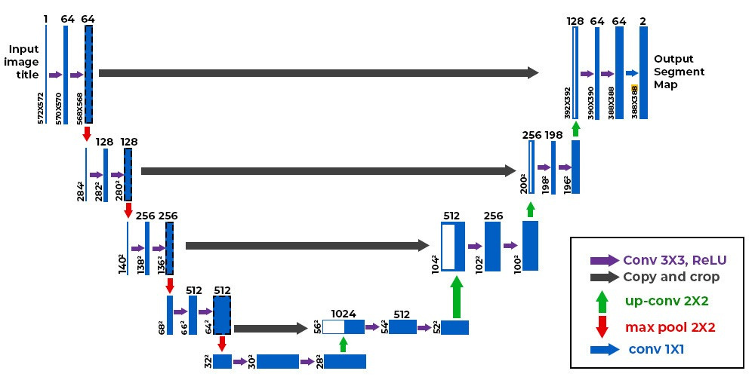
UNET ARCHITECTURE

Slide 24
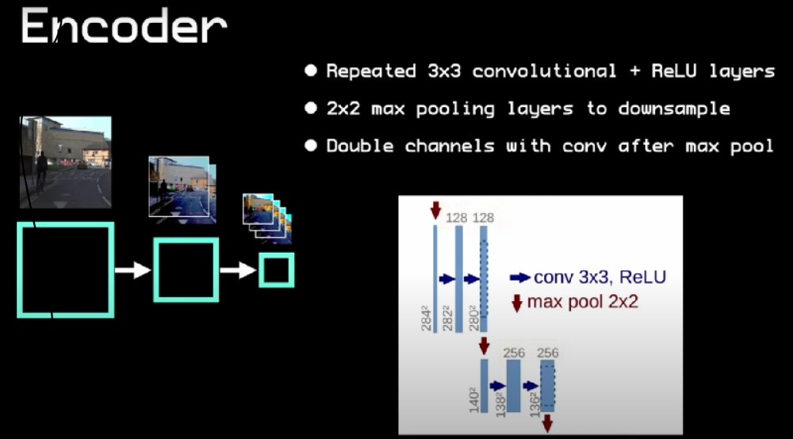
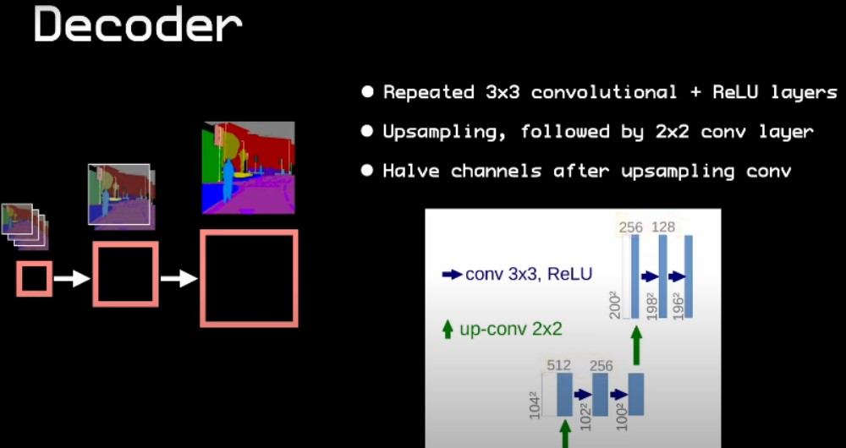
UNET ARCHITECTURE

Slide 25
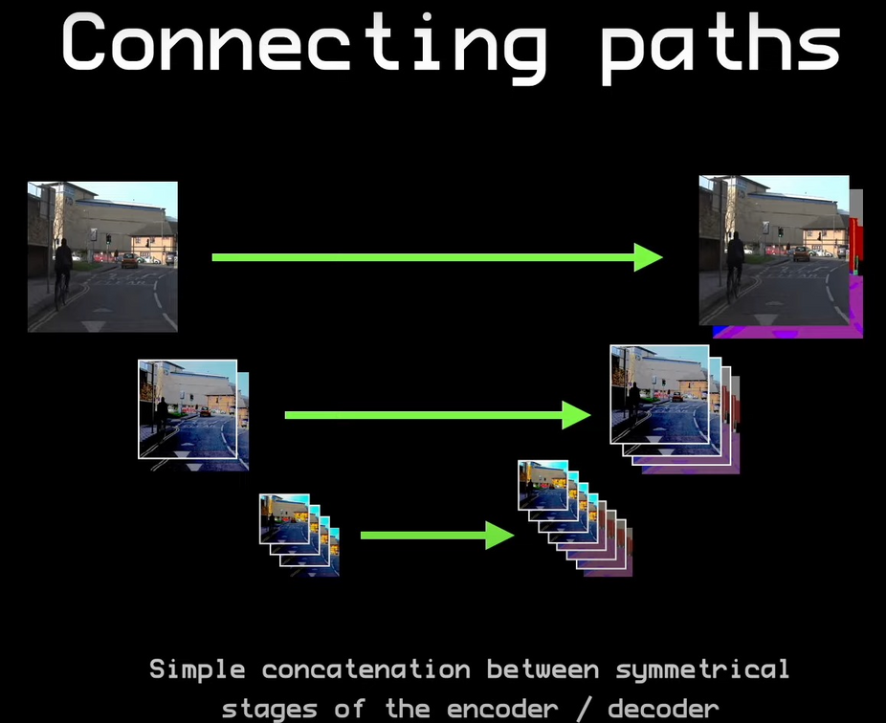
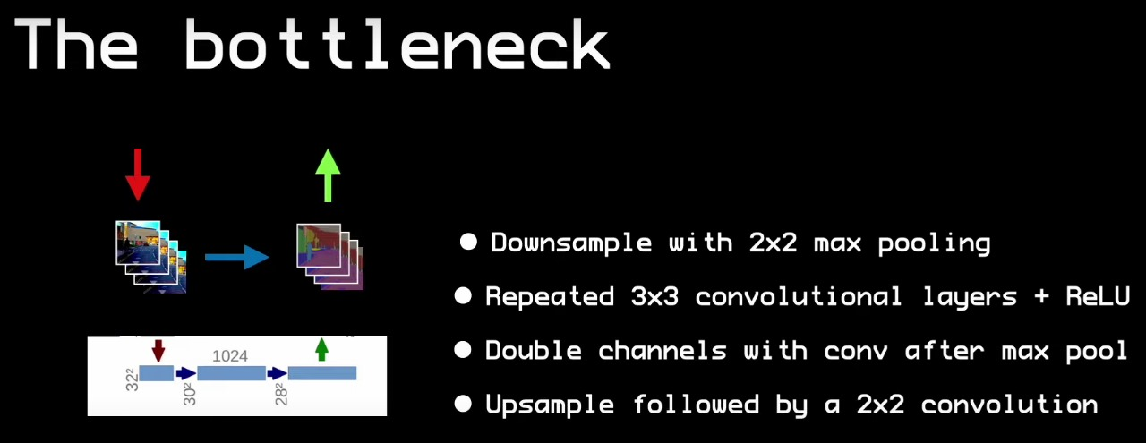
UNET ARCHITECTURE

Slide 26
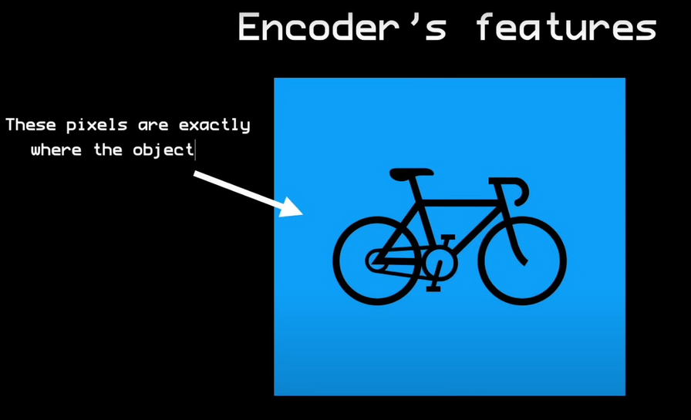
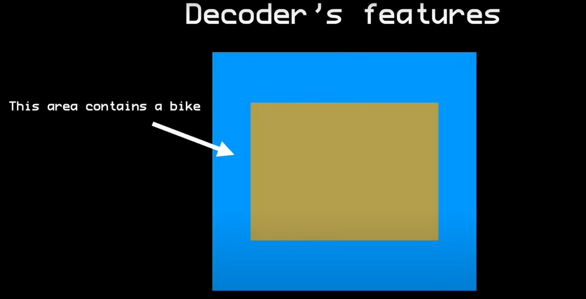
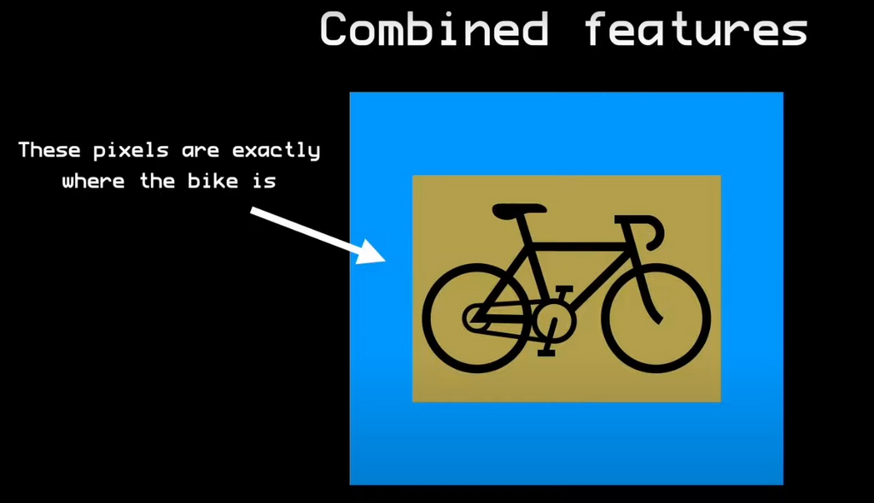
UNET ARCHITECTURE

Slide 27
UNET ARCHITECTURE
1.Contracting Path (Encoder)
The encoder is responsible for capturing high-level features and reducing the spatial dimensions of the input image.
It consists of repeated blocks of convolutional layers followed by max-pooling layers, effectively downsampling the input.
2. Bottleneck
At the center of the U-Net is a bottleneck layer that captures the most critical features while maintaining spatial information.
3. Expansive Path (Decoder)
The decoder is responsible for upsampling the low-resolution feature maps to match the original input size.
It consists of repeated blocks of transposed convolutions (upsampling) followed by concatenation with corresponding feature maps from the contracting path

Slide 28
UNET++
UNet++ uses the Dense block ideas from DenseNet to improve U-Net.
UNet++ differs from the original U-Net in three ways:
1) having convolution layers on skip pathways, which bridges the semantic gap between encoder and decoder feature maps.
2) having dense skip connections on skip pathways, which improves gradient flow.
3) having deep supervision, which enables model pruning and improves or in the worst case achieves comparable performance to using only one loss layer.

Slide 29
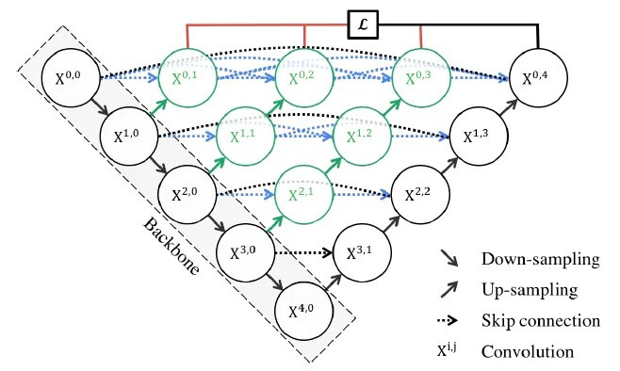

UNet++ starts with an encoder sub-network or backbone followed by a decoder sub-network.
There are re-designed skip pathways (green and blue) that connect the two sub-networks and the use of deep supervision (red).
5

Slide 30
PREVIOUS RELEVANT WORK
Computed tomography (CT) is the preferred imaging method for diagnosing 2019 novel coronavirus
(COVID19) pneumonia. We aimed to construct a system based on deep learning for detecting COVID-
19 pneumonia on high resolution CT. For model development and validation, 46,096 anonymous
images from 106 admitted patients, including 51 patients of laboratory confrmed COVID-19
pneumonia and 55 control patients of other diseases in Renmin Hospital of Wuhan University
were retrospectively collected.

Slide 31
DATA SET
Computed tomography (CT) is the preferred imaging method for diagnosing 2019 novel coronavirus
(COVID19) pneumonia. We aimed to construct a system based on deep learning for detecting COVID-
19 pneumonia on high resolution CT. For model development and validation, 46,096 anonymous
images from 106 admitted patients, including 51 patients of laboratory confrmed COVID-19
pneumonia and 55 control patients of other diseases in Renmin Hospital of Wuhan University
were retrospectively collected.

Slide 32
PREVIOUS REEVANT WORK
Training algorithm. Tis work is built on the top of UNet++, a novel and powerful architecture for medical image segmentation19, for the identifcation. Resnet-50 was used as backbone of UNet++ as previously described20. ResNet-5021 was pretrained using ImageNet dataset22, and all the pre-training parameters of ResNet-50 are loaded to UNet++.

Slide 33
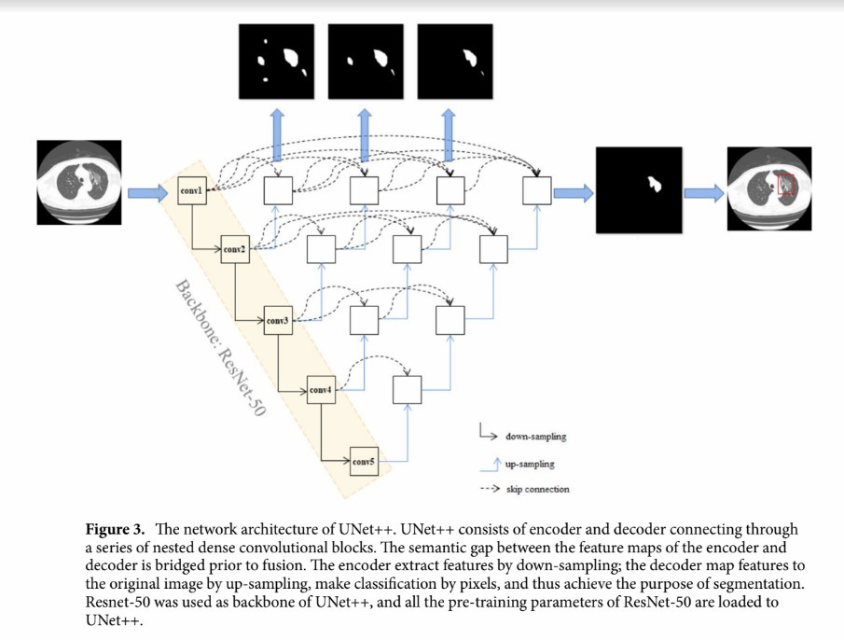


Slide 34
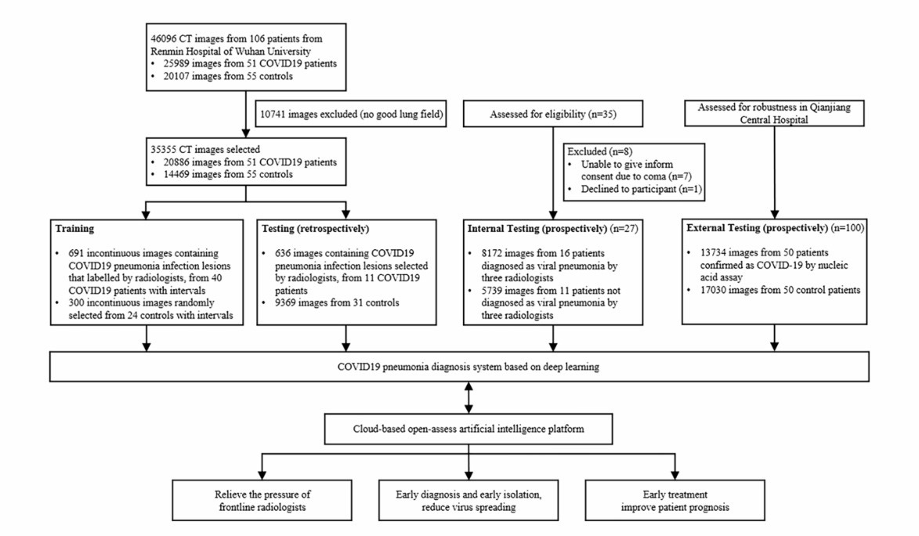
Figure - Workfow diagram for the development and evaluation of the model for detecting COVID19 pneumonia.

Slide 35
PREVIOUS REEVANT WORK
Comparison between the efficiency of radiologist with or without the assistance of AI. In the
frst time the expert radiologist read CT scan images of the 27 prospective patients, the average reading time forhim to determine whether each patient has viral pneumonia was 116.12 s per case (IQR 85.69–118.17).
After 10 days of wash out period, the same expert radiologist re-read the CT images of the 27 prospective patients with the assistance of the AI model. Te results for determining whether each patient has viral pneumonia were not changed, while the average reading time of the expert was greatly decreased by 65%. Tis indicates that the efciency of radiologist could be greatly improved with the assistance of AI.

Slide 36
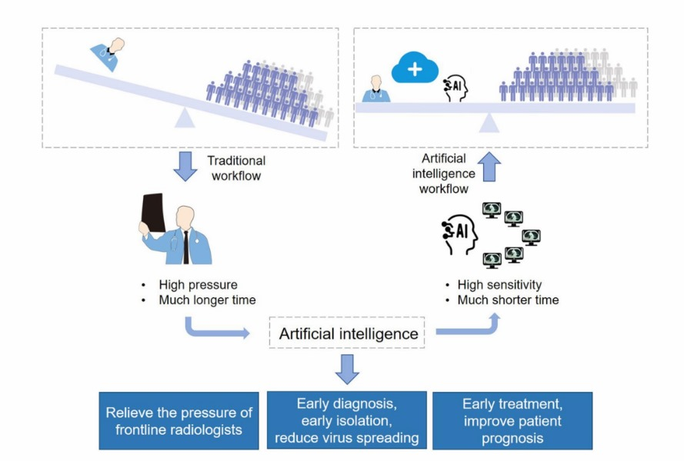
CONCLUSION

Slide 37
CONCLUSION
Computed tomography (CT) is the most effcient modality for screening and
clinically diagnosing COVID-19 pneumonia. However, compared to the needs of the patients, the number of radiologists is quite small.
After enrolling artifcial intelligence in identifying COVID-19 pneumonia in CT
images, the efciency of diagnosis is greatly improved. The artifcial intelligence holds great potential to relieve
the pressure of frontline radiologists,
accelerates the diagnosis,
isolation and treatment of COVID19 patients and therefore contribute to the control of the epidemic.

Slide 38
REFERENCE
1. Deep learning-based model for detecting 2019 novel coronavirus pneumonia on high-resolution computed tomography
Jun Chen, Lianlian Wu, Jun Zhang, Liang Zhang, Dexin Gong, Yilin Zhao, Qiuxiang Chen, Shulan Huang, Ming Yang, Xiao Yang, Shan Hu, Yonggui Wang, Xiao Hu, Biqing Zheng, Kuo Zhang, Huiling Wu, Zehua Dong, Youming Xu, Yijie Zhu, Xi Chen, Mengjiao Zhang, Lilei Yu, Fan Cheng & Honggang Yu
Supplementary information is available for this paper at https://doi.org/10.1038/s41598-020-76282-0
Correspondence and requests for materials should be addressed to L.Y., F.C. or H.Y.
Reprints and permissions information is available at www.nature.com/reprints.
2. He, K., Zhang, X., Ren, S. & Sun, J. Deep residual learning for image recognition. IEEE conference on computer vision and pattern recognition. 770–778, (2016).
3. Zhou, Z., Siddiquee, M. M. R., Tajbakhsh, N. & Liang, J. Unet++: a nested u-net architecture for medical image segmentation. Preprint at. https://arxiv.org/abs/1807.10165 (2018).

Slide 39
REFERENCE
3. Chen, L., Papandreou, G., Schrof, F. & Adam, H. Rethinking atrous convolution for semantic image segmentation. Preprint at.
https://arxiv.org/abs/1706.05587 (2017).
5. J. Long, E. Shelhamer, and T. Darrell. Fully convolutional networks for seman?tic segmentation. In Proceedings of the IEEE conference on computer vision and pattern recognition, pages 3431–3440, 2015.
6. O. Ronneberger, P. Fischer, and T. Brox. U-net: Convolutional networks for biomedical image segmentation. In International Conference on Medical image computing and computer-assisted intervention, pages 234–241. Springer, 2015.
7. Automatic prediction of COVID− 19 from chest images using modified ResNet50 Marwa Elpeltagycorresponding author1 and Hany Sallam2
https://www.ncbi.nlm.nih.gov/pmc/articles/PMC8095476/#:~:text=In%20this%20study%2C%20the%20efficacy,extract%20the%20best%20discriminative%20features

Slide 40
Looking forward to your encouragement and support for our development
SUBMISSION
Thank You
IT, GCECT

